Slide 1
Python with Data Science
Data Visualization & APIs

Slide 2
What Is Data Visualization?
Data visualization means turning numbers into pictures — charts, graphs, and maps — so our brains can spot patterns quickly. A chart showing sales rising over 6 months is far easier to understand than a spreadsheet of raw numbers.
Why It Matters
🧠 Brain-friendly — we process visuals 60,000× faster than text
🔍 Spot patterns — trends and outliers jump out instantly
📊 Tell stories — data becomes a narrative anyone can follow
⚡ Faster decisions — leaders act on clear visuals, not raw tables
Real-World Applications
🏥 Healthcare
💰 Finance
🛒 E-Commerce
Track disease outbreaks, patient recovery rates, and hospital bed occupancy with live dashboards.
Monitor stock prices, portfolio performance, and spending trends in real time.
Analyze sales by category, customer behavior, and product popularity to drive revenue.
📱 Social Media
🌤️ Weather
Measure engagement, follower growth, and post reach to refine content strategy.
Visualize temperature trends, rainfall patterns, and storm tracks for forecasts.
Types of Charts — When to Use Each
Line Chart
Bar Chart
Show change over time — stock prices, temperature trends, website traffic.
Compare categories — sales by product, population by city, exam scores by subject.
Pie Chart
Show parts of a whole — budget breakdown, market share, survey responses.
Histogram
Scatter Plot
Reveal how data is distributed — age groups, salary ranges, test scores.
Show relationships — study hours vs. grades, ad spend vs. revenue.
Find patterns and fix errors

Slide 3
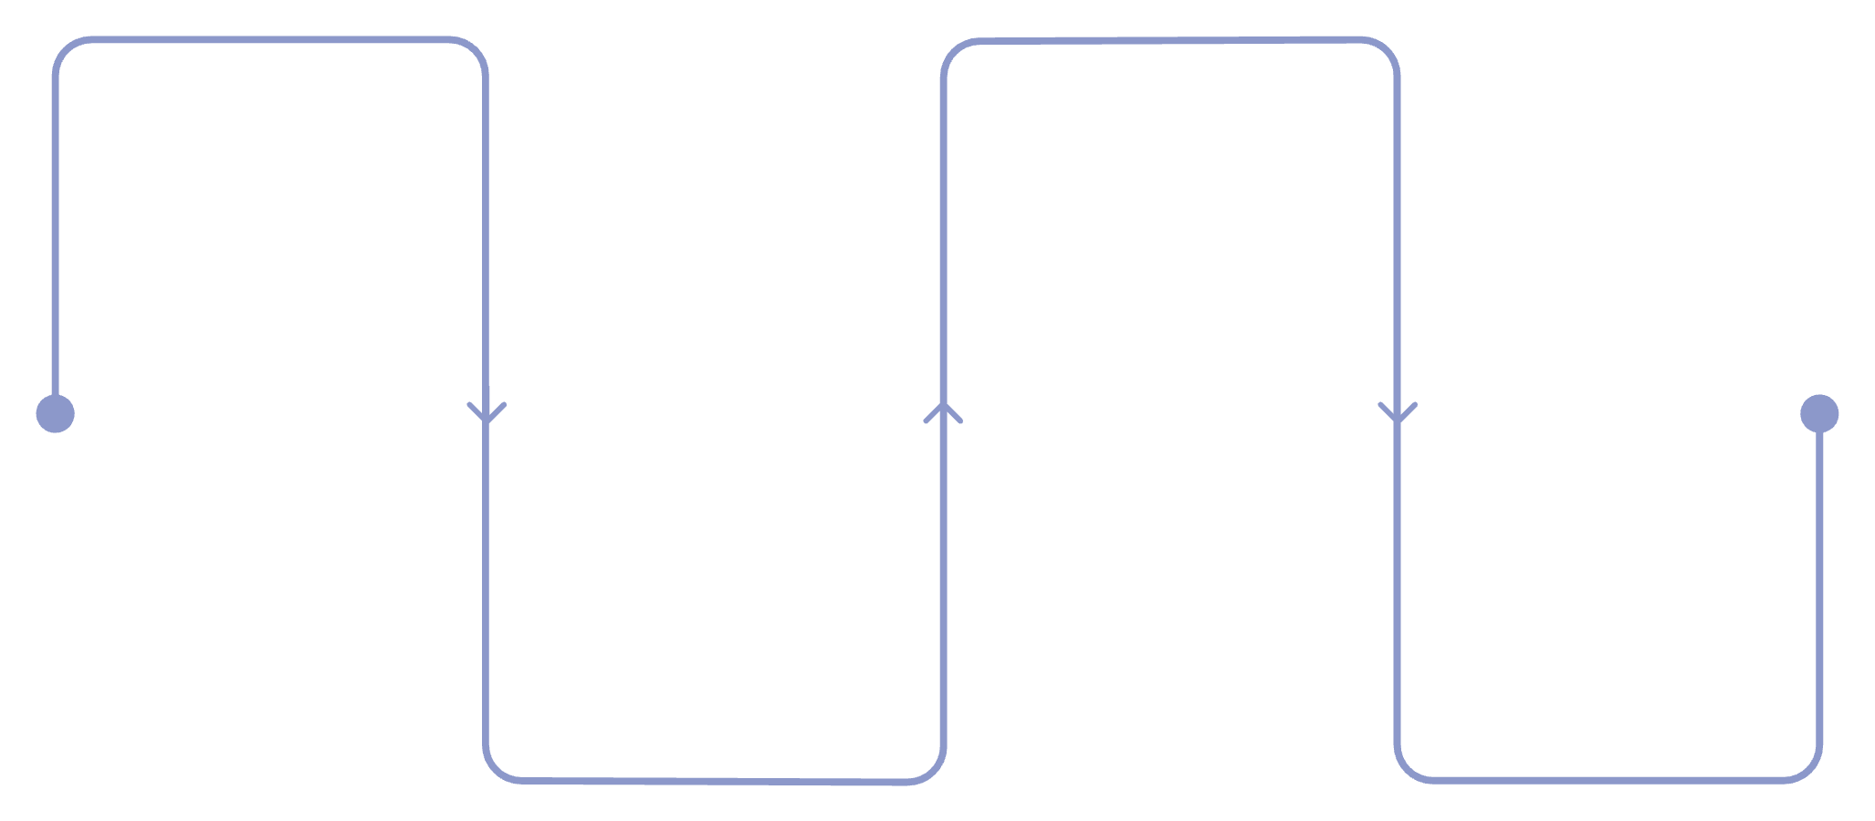
Good vs. Bad Visualization
❌ Bad Visualization
✅ Good Visualization
Clear title and labeled axes
Minimal clutter — only essential info
Consistent, readable colors
Correct chart type for the data
Tells a clear story at a glance
Missing labels or confusing titles
Too many colors or 3D effects
Misleading scales or truncated axes
Wrong chart type (e.g., pie for time data)
Overloaded with too much information
Where Visualization Fits in Data Science
Collect Data
Visualize
APIs, databases, files
Create clear charts and graphs
Clean & Explore
Communicate
Find patterns and fix errors
Share findings and decisions
Visualization is both an exploration tool (finding patterns early) and a communication tool (sharing results clearly). It appears at multiple stages of the workflow.
📝 Practice Exercise: Think of a dataset you encounter daily (weather, fitness, social media). What chart type would best represent it, and why?

Slide 4
Introduction to Matplotlib
Matplotlib is Python's most popular library for creating charts and graphs. Think of it as your digital graph paper — you give it numbers, and it draws beautiful, customizable plots for you.
Why Use Matplotlib?
Installation & Import
Free and open-source
Works with NumPy and Pandas
Highly customizable
Huge community and documentation
Foundation for Seaborn and other libraries
Run this in your terminal or command prompt:
pip install matplotlib
Then import it in your Python script:
import matplotlib.pyplot as plt
We use as plt as a nickname — it's shorter and the standard convention everyone uses.
Structure of a Basic Plot
01
02
03
Import the library
Prepare your data
Create the plot
import matplotlib.pyplot as plt
Create lists or arrays of numbers to plot
Use plt.plot(), plt.bar(), etc.
04
05
Customize it
Display it
Add titles, labels, colors, and legends
Call plt.show() to see your chart
Your First Matplotlib Code
import matplotlib.pyplot as plt
# Step 1: Prepare data
months = ["Jan", "Feb", "Mar", "Apr"]
sales = [3000, 4200, 3800, 5100]
# Step 2: Create the plot
plt.plot(months, sales)
# Step 3: Add labels and title
plt.title("Monthly Sales")
plt.xlabel("Month")
plt.ylabel("Sales ($)")
# Step 4: Show the chart
plt.show()
📊 Expected Output: A line chart showing sales rising from $3,000 in January to $5,100 in April. The x-axis shows months; the y-axis shows dollar amounts.
💡 Key Concept: Every Matplotlib chart follows the same pattern: import → prepare data → plot → customize → show. Master this flow and you can create any chart!

Slide 5
Line Charts — plt.plot()
A line chart connects data points with a line, perfect for showing how something changes over time — like temperature, stock prices, or student grades across semesters.
Syntax Breakdown
📈 Student Marks Trend
plt.plot(x, y,
color='blue',
linestyle='--',
marker='o',
linewidth=2)
import matplotlib.pyplot as plt
terms = ["Term 1", "Term 2", "Term 3", "Term 4"]
marks = [65, 72, 80, 88]
plt.plot(terms, marks,
color='purple',
marker='o',
linewidth=2)
plt.title("Student Marks Over Time")
plt.xlabel("Term")
plt.ylabel("Marks (%)")
plt.show()
x — horizontal values (time, categories)
y — vertical values (measurements)
color — 'red', 'green', 'blue', etc.
linestyle — '-', '--', '-.', ':'
marker — 'o', 's', '^', '*'
linewidth — thickness of the line
Output: An upward-sloping line showing improvement from 65% to 88% across four terms.
More Line Chart Examples
🌡️ Temperature Analysis
📊 Stock Market Trend
days = ["Mon","Tue","Wed","Thu","Fri"]
temp = [28, 31, 29, 33, 30]
plt.plot(days, temp,
color='red',
linestyle='--',
marker='s')
plt.title("Weekly Temperature")
plt.show()
weeks = ["W1","W2","W3","W4"]
stock = [150, 147, 155, 162]
plt.plot(weeks, stock,
color='green',
marker='^',
linewidth=3)
plt.title("Stock Price Trend")
plt.show()
Output: A dashed red line with square markers showing daily temperature fluctuations between 28°C and 33°C.
Output: A thick green line with triangle markers showing stock recovery from $147 to $162 over four weeks.
📝 Practice Exercise: Create a line chart showing your daily screen time for a week. Use color='orange' and marker='*'. What trend do you notice?

Slide 6
Bar Charts — plt.bar()
A bar chart uses rectangular bars to compare values across categories. Taller bars = bigger values. Perfect for comparing sales, populations, scores, or anything you can count!
Vertical Bar Chart Syntax
🛒 Sales Comparison Example
plt.bar(x, height,
color='blue',
width=0.4)
import matplotlib.pyplot as plt
products = ["Laptop", "Phone", "Tablet", "Watch"]
sales = [450, 620, 310, 180]
plt.bar(products, sales,
color='steelblue',
width=0.5)
plt.title("Product Sales Comparison")
plt.xlabel("Product")
plt.ylabel("Units Sold")
plt.show()
x — category labels (x-axis)
height — values (y-axis)
color — bar color
width — bar thickness (default 0.8)
Output: Four vertical bars — Phone tallest (620 units), Watch shortest (180 units).
More Bar Chart Examples
📚 Student Performance
🌍 Population Comparison
subjects = ["Math","Science","English","History"]
scores = [85, 92, 78, 88]
plt.bar(subjects, scores,
color=['red','green','blue','orange'])
plt.title("Subject-wise Scores")
plt.ylim(0, 100) # y-axis from 0 to 100
plt.show()
cities = ["NYC", "Tokyo", "London", "Paris"]
pop = [8.4, 13.9, 9.0, 2.1] # millions
plt.bar(cities, pop, color='purple')
plt.title("City Populations (Millions)")
plt.show()
Output: Tokyo's bar towers over the rest at 13.9 million; Paris is the smallest at 2.1 million.
Output: Colorful bars for each subject. Science is highest (92), English lowest (78). ylim(0,100) sets a consistent scale.
📝 Practice Exercise: Make a bar chart of your 5 favorite foods rated 1–10. Use different colors for each bar. Which food has the tallest bar?

Slide 7

Horizontal Bar Charts — plt.barh()
A horizontal bar chart flips the bars sideways. Use it when category names are long, you have many categories, or you want to emphasize rankings from top to bottom.
bar() vs barh()
Basic Syntax
plt.bar() — Vertical
plt.barh() — Horizontal
plt.barh(y, width,
color='teal',
height=0.5)
Categories on x-axis (bottom). Best for short labels and few categories.
Categories on y-axis (left). Best for long labels or many categories.
y — category labels (y-axis)
width — bar lengths (x-axis values)
height — thickness of each bar
Practical Examples
📱 App Usage Time (Hours/Day)
🏆 Sports Team Rankings
💼 Department Budget Allocation
import matplotlib.pyplot as plt
apps = ["Instagram", "YouTube", "WhatsApp", "TikTok", "Gmail"]
hours = [2.5, 3.0, 1.5, 2.0, 1.0]
plt.barh(apps, hours, color='coral')
plt.title("Daily App Usage")
plt.xlabel("Hours per Day")
plt.show()
teams = ["Team A", "Team B", "Team C", "Team D"]
points = [78, 91, 65, 84]
plt.barh(teams, points,
color=['gold','silver','#CD7F32','gray'])
plt.title("League Points Table")
plt.xlabel("Points")
plt.show()
depts = ["Marketing", "Engineering", "HR", "Sales", "Support"]
budget = [120, 340, 80, 200, 95] # in $K
plt.barh(depts, budget, color='navy')
plt.title("Department Budget ($K)")
plt.xlabel("Budget Allocation")
plt.show()
Output: Engineering dominates with $340K. HR has the smallest budget at $80K. Horizontal layout makes department names easy to read.
Output: Team B leads with 91 points (gold bar). Rankings are immediately visible from top to bottom.
Output: YouTube has the longest bar (3 hrs), Gmail the shortest (1 hr). Easy to read with long app names on the left.
💡 Pro Tip: Use plt.barh() whenever your category names would overlap or get cut off in a vertical bar chart. It's the go-to for readability!

Slide 8
Pie Charts — plt.pie()
A pie chart shows how parts make up a whole. Each "slice" represents a percentage — perfect for budgets, market share, or survey results that add up to 100%.
Key Parameters
📊 Market Share Example
plt.pie(sizes,
labels=names,
autopct='%1.1f%%',
explode=(0,0.1,0,0),
shadow=True,
colors=['r','g','b','y'])
import matplotlib.pyplot as plt
brands = ["Samsung", "Apple", "Xiaomi", "Oppo", "Others"]
share = [30, 25, 20, 15, 10]
plt.pie(share,
labels=brands,
autopct='%1.1f%%',
explode=(0.1,0,0,0,0),
shadow=True)
plt.title("Mobile Brand Market Share")
plt.show()
sizes — the values for each slice
labels — category names
autopct — shows % on each slice
explode — pulls a slice outward
shadow — adds a 3D shadow effect
colors — custom slice colors
Output: A colorful pie with Samsung's slice pulled out (exploded). Each slice shows its percentage. Samsung leads at 30%.
More Pie Chart Examples
💰 Monthly Budget
📱 Mobile Brand Usage Survey
categories = ["Rent", "Food", "Transport", "Entertainment", "Savings"]
amounts = [800, 400, 200, 150, 450]
plt.pie(amounts, labels=categories,
autopct='%1.1f%%',
colors=['#8C98CA','#FF6B6B','#4ECDC4','#FFE66D','#95E1D3'])
plt.title("My Monthly Budget")
plt.show()
brands = ["Android", "iOS", "KaiOS", "Others"]
users = [65, 30, 3, 2]
plt.pie(users, labels=brands,
autopct='%1.1f%%',
startangle=90) # rotates the chart
plt.title("OS Usage Among Students")
plt.show()
Output: Rent takes the biggest slice ($800). Savings is second ($450). Percentages auto-calculated on each slice.
Output: Android dominates at 65%, iOS at 30%. startangle=90 rotates the chart so the largest slice starts at the top.
⚠️ When NOT to Use Pie Charts: Avoid pie charts when you have more than 6 categories, when values are very similar, or when comparing changes over time. Use bar charts instead for clearer comparisons.

Slide 9
Histograms — plt.hist()
A histogram shows how data is distributed — how many values fall into each range (called a bin). Unlike a bar chart (which compares categories), a histogram reveals patterns in continuous data like ages, scores, or salaries.
Histogram vs Bar Chart
Syntax
Bar Chart
Histogram
plt.hist(data,
bins=10,
color='skyblue',
edgecolor='black')
Compares categories. Bars have gaps. Order doesn't matter.
Shows distributions. Bars touch. Order matters (low to high).
Bins = the number of groups your data is split into. More bins = more detail.
data — list of numbers
bins — number of groups
color — fill color
edgecolor — bar border color
Histogram Examples
📚 Student Marks Distribution
👥 Age Distribution
💵 Salary Distribution
import matplotlib.pyplot as plt
marks = [55,60,62,65,68,70,72,72,75,78,
80,82,84,85,85,88,90,92,95,98]
plt.hist(marks, bins=5,
color='steelblue',
edgecolor='black')
plt.title("Student Marks Distribution")
plt.xlabel("Marks Range")
plt.ylabel("Number of Students")
plt.show()
ages = [18,19,20,20,21,21,21,22,22,23,
24,25,26,28,30,32,35,40,45,50]
plt.hist(ages, bins=8,
color='coral',
edgecolor='black')
plt.title("Age Distribution of Participants")
plt.xlabel("Age")
plt.ylabel("Frequency")
plt.show()
salaries = [25,28,30,32,35,38,40,42,45,48,
50,55,60,65,70,80,95,120] # in $K
plt.hist(salaries, bins=6,
color='green',
edgecolor='black')
plt.title("Employee Salary Distribution")
plt.xlabel("Salary ($K)")
plt.ylabel("Number of Employees")
plt.show()
Output: Most participants are 20–25 (tallest bar). Fewer people in older age groups, creating a right-skewed distribution.
Output: Most employees earn $25K–$50K. Very few earn above $80K, showing a typical right-skewed salary distribution.
Output: 5 bars showing how many students scored in each range (e.g., 55–70, 71–85, etc.). Most students cluster in the middle ranges.
📝 Practice Exercise: Collect 20 numbers from your daily life (steps walked, hours slept, etc.). Plot a histogram with bins=5. What does the shape tell you?

Slide 10
Scatter Plots — plt.scatter()
A scatter plot shows the relationship between two variables using dots. Each dot is one observation. Look for patterns — do the dots form a line? A cluster? This reveals correlation.
Correlation Types
Syntax
↗️ Positive
↘️ Negative
plt.scatter(x, y,
color='blue',
s=50, # dot size
alpha=0.6) # transparency
Both variables increase together. Dots slope upward. Example: study hours → marks.
One increases, the other decreases. Dots slope downward. Example: screen time → sleep.
x — first variable (horizontal)
y — second variable (vertical)
s — size of each dot
alpha — transparency (0 to 1)
⟷ No Correlation
No pattern — dots are scattered randomly. Example: shoe size → IQ.
Scatter Plot Examples
📖 Study Hours vs Marks
📏 Height vs Weight
📢 Advertising vs Sales
import matplotlib.pyplot as plt
hours = [1,2,3,4,5,6,7,8,9,10]
marks = [45,52,58,65,70,78,83,88,92,96]
plt.scatter(hours, marks,
color='purple',
s=80,
alpha=0.7)
plt.title("Study Hours vs Exam Marks")
plt.xlabel("Hours Studied")
plt.ylabel("Marks (%)")
plt.show()
height = [150,155,160,165,170,175,180,185]
weight = [50,54,58,63,68,74,80,87]
plt.scatter(height, weight,
color='teal',
s=100,
alpha=0.6)
plt.title("Height vs Weight")
plt.xlabel("Height (cm)")
plt.ylabel("Weight (kg)")
plt.show()
ad_spend = [100,200,300,400,500,600,700]
sales = [1200,1800,2100,2600,2900,3400,3700]
plt.scatter(ad_spend, sales,
color='red',
s=90,
alpha=0.7)
plt.title("Ad Spend vs Sales Revenue")
plt.xlabel("Ad Spend ($)")
plt.ylabel("Sales ($)")
plt.show()
Output: Taller people tend to weigh more — another positive correlation. The dots form a clear upward trend.
Output: Strong positive correlation — more ad spend drives higher sales. Businesses use this insight to optimize marketing budgets.
Output: Dots slope upward — clear positive correlation. More study hours = higher marks. The pattern is almost a straight line!
📝 Practice Exercise: Track your daily screen time and hours of sleep for 7 days. Plot a scatter plot. Do you see a positive or negative correlation?

Slide 11
Labels, Titles & Legends
A chart without labels is like a map without a legend — confusing! Adding titles, axis labels, and legends makes your charts professional, clear, and easy for anyone to understand.
Key Functions
Before vs After
plt.title("My Chart")
❌ Without Labels:
Adds a title at the top of the chart.
plt.plot(months, sales_2023)
plt.plot(months, sales_2024)
plt.show()
plt.xlabel("X-Axis")
Labels the horizontal axis.
Two lines appear, but viewers have no idea what they represent or which is which.
✅ With Labels:
plt.ylabel("Y-Axis")
Labels the vertical axis.
plt.legend()
plt.plot(months, sales_2023,
label="2023")
plt.plot(months, sales_2024,
label="2024")
plt.title("Monthly Sales Comparison")
plt.xlabel("Month")
plt.ylabel("Sales ($)")
plt.legend()
plt.grid(True)
plt.show()
Shows a key explaining each line or bar.
Now it's crystal clear — title, axis labels, legend, and even a grid!
Complete Example with All Elements
import matplotlib.pyplot as plt
months = ["Jan","Feb","Mar","Apr","May","Jun"]
tea = [120,135,128,150,162,175]
coffee = [95,110,105,130,140,155]
plt.plot(months, tea,
color='brown',
marker='o',
label="Tea Sales")
plt.plot(months, coffee,
color='black',
marker='s',
label="Coffee Sales")
plt.title("Beverage Sales — First Half of Year")
plt.xlabel("Month")
plt.ylabel("Units Sold")
plt.legend(loc="upper left")
plt.grid(True, alpha=0.3)
plt.show()
📊 Expected Output: Two colored lines (brown for Tea, black for Coffee) on one chart. A legend identifies each line. A grid helps read exact values. Both lines trend upward, showing growth.
📝 Practice Exercise: Take any chart you've built so far and add a title, x-label, y-label, legend, and plt.grid(True). How much clearer does it become?

Slide 12
Subplots — plt.subplot()
Subplots let you display multiple charts in a single figure — like a photo collage for data! Perfect for comparing different views of your data side by side.
Understanding Rows & Columns
Why Use Subplots?
plt.subplot(rows, cols, index)
Compare multiple datasets at once
Show different chart types together
Create dashboard-style reports
Save space in presentations
rows — how many rows of charts
cols — how many columns of charts
index — which chart you're drawing (1, 2, 3…)
plt.subplot(2, 2, 1) = a 2×2 grid, drawing chart #1 (top-left).
Subplot Examples
📊 2×1 Grid — Sales & Profit
📈 2×2 Grid — Four Chart Types
import matplotlib.pyplot as plt
months = ["Jan","Feb","Mar","Apr"]
sales = [3000,4200,3800,5100]
profit = [800,1100,950,1400]
plt.subplot(2, 1, 1) # Row 1
plt.plot(months, sales, color='blue')
plt.title("Sales Trend")
plt.subplot(2, 1, 2) # Row 2
plt.bar(months, profit, color='green')
plt.title("Profit Trend")
plt.tight_layout()
plt.show()
categories = ["A","B","C","D"]
values = [23,45,56,78]
plt.subplot(2,2,1)
plt.plot(categories, values, 'r-o')
plt.title("Line")
plt.subplot(2,2,2)
plt.bar(categories, values, color='blue')
plt.title("Bar")
plt.subplot(2,2,3)
plt.pie(values, labels=categories, autopct='%1.1f%%')
plt.title("Pie")
plt.subplot(2,2,4)
plt.hist(values, bins=4, color='orange')
plt.title("Histogram")
plt.tight_layout()
plt.show()
Output: Two stacked charts — a line chart for sales on top, a bar chart for profit below. Both share the same months.
Output: Four different chart types in one figure — line, bar, pie, and histogram — each showing the same data from a different angle.
📝 Practice Exercise: Create a 2×2 subplot showing: (1) a line chart of your weekly mood, (2) a bar chart of hours slept, (3) a pie chart of how you spend your day, (4) a histogram of your screen time. Use plt.tight_layout() to prevent overlap!

Slide 13

Figure Size and DPI
Mastering figsize and dpi is crucial for creating professional, high-quality plots. These settings directly impact the dimensions and resolution of your visualizations.
Understanding the Basics
Why Image Quality Matters
figsize=(width, height)
Clarity: Prevents pixelation and blurry text when plots are scaled or printed.
Professionalism: High-resolution images are essential for reports, presentations, and academic publications.
Readability: Ensures all labels, titles, and data points are easily discernible, even in complex plots.
Determines the figure's dimensions in inches. A larger figure provides more space for elements, preventing clutter.
dpi=dots_per_inch
Sets the resolution (dots per inch). Higher DPI means more pixels per inch, resulting in a sharper, clearer image, especially for printing.
A typical screen resolution is 72-96 dpi, while print often requires 300 dpi or more.
Comparing Figure Sizes
Observe how figsize dramatically changes the visual presentation of a simple plot, giving elements more room to breathe.
Default Figure Size
Larger Figure Size
import matplotlib.pyplot as plt
x = [1, 2, 3, 4, 5]
y = [2, 4, 1, 5, 2]
plt.plot(x, y, marker='o')
plt.title("Default Size Plot")
plt.xlabel("X-Axis")
plt.ylabel("Y-Axis")
plt.show()
import matplotlib.pyplot as plt
x = [1, 2, 3, 4, 5]
y = [2, 4, 1, 5, 2]
plt.figure(figsize=(10, 6)) # 10 inches wide, 6 inches tall
plt.plot(x, y, marker='o', color='purple', linewidth=2)
plt.title("Larger Figure Size Plot", fontsize=14)
plt.xlabel("X-Axis", fontsize=12)
plt.ylabel("Y-Axis", fontsize=12)
plt.grid(True, linestyle='--', alpha=0.6)
plt.show()
This plot uses the default figure size, which can sometimes feel cramped, especially with more data or labels.
By setting figsize=(10, 6), the plot has more breathing room, improving readability and visual impact without changing the underlying data.

Slide 14
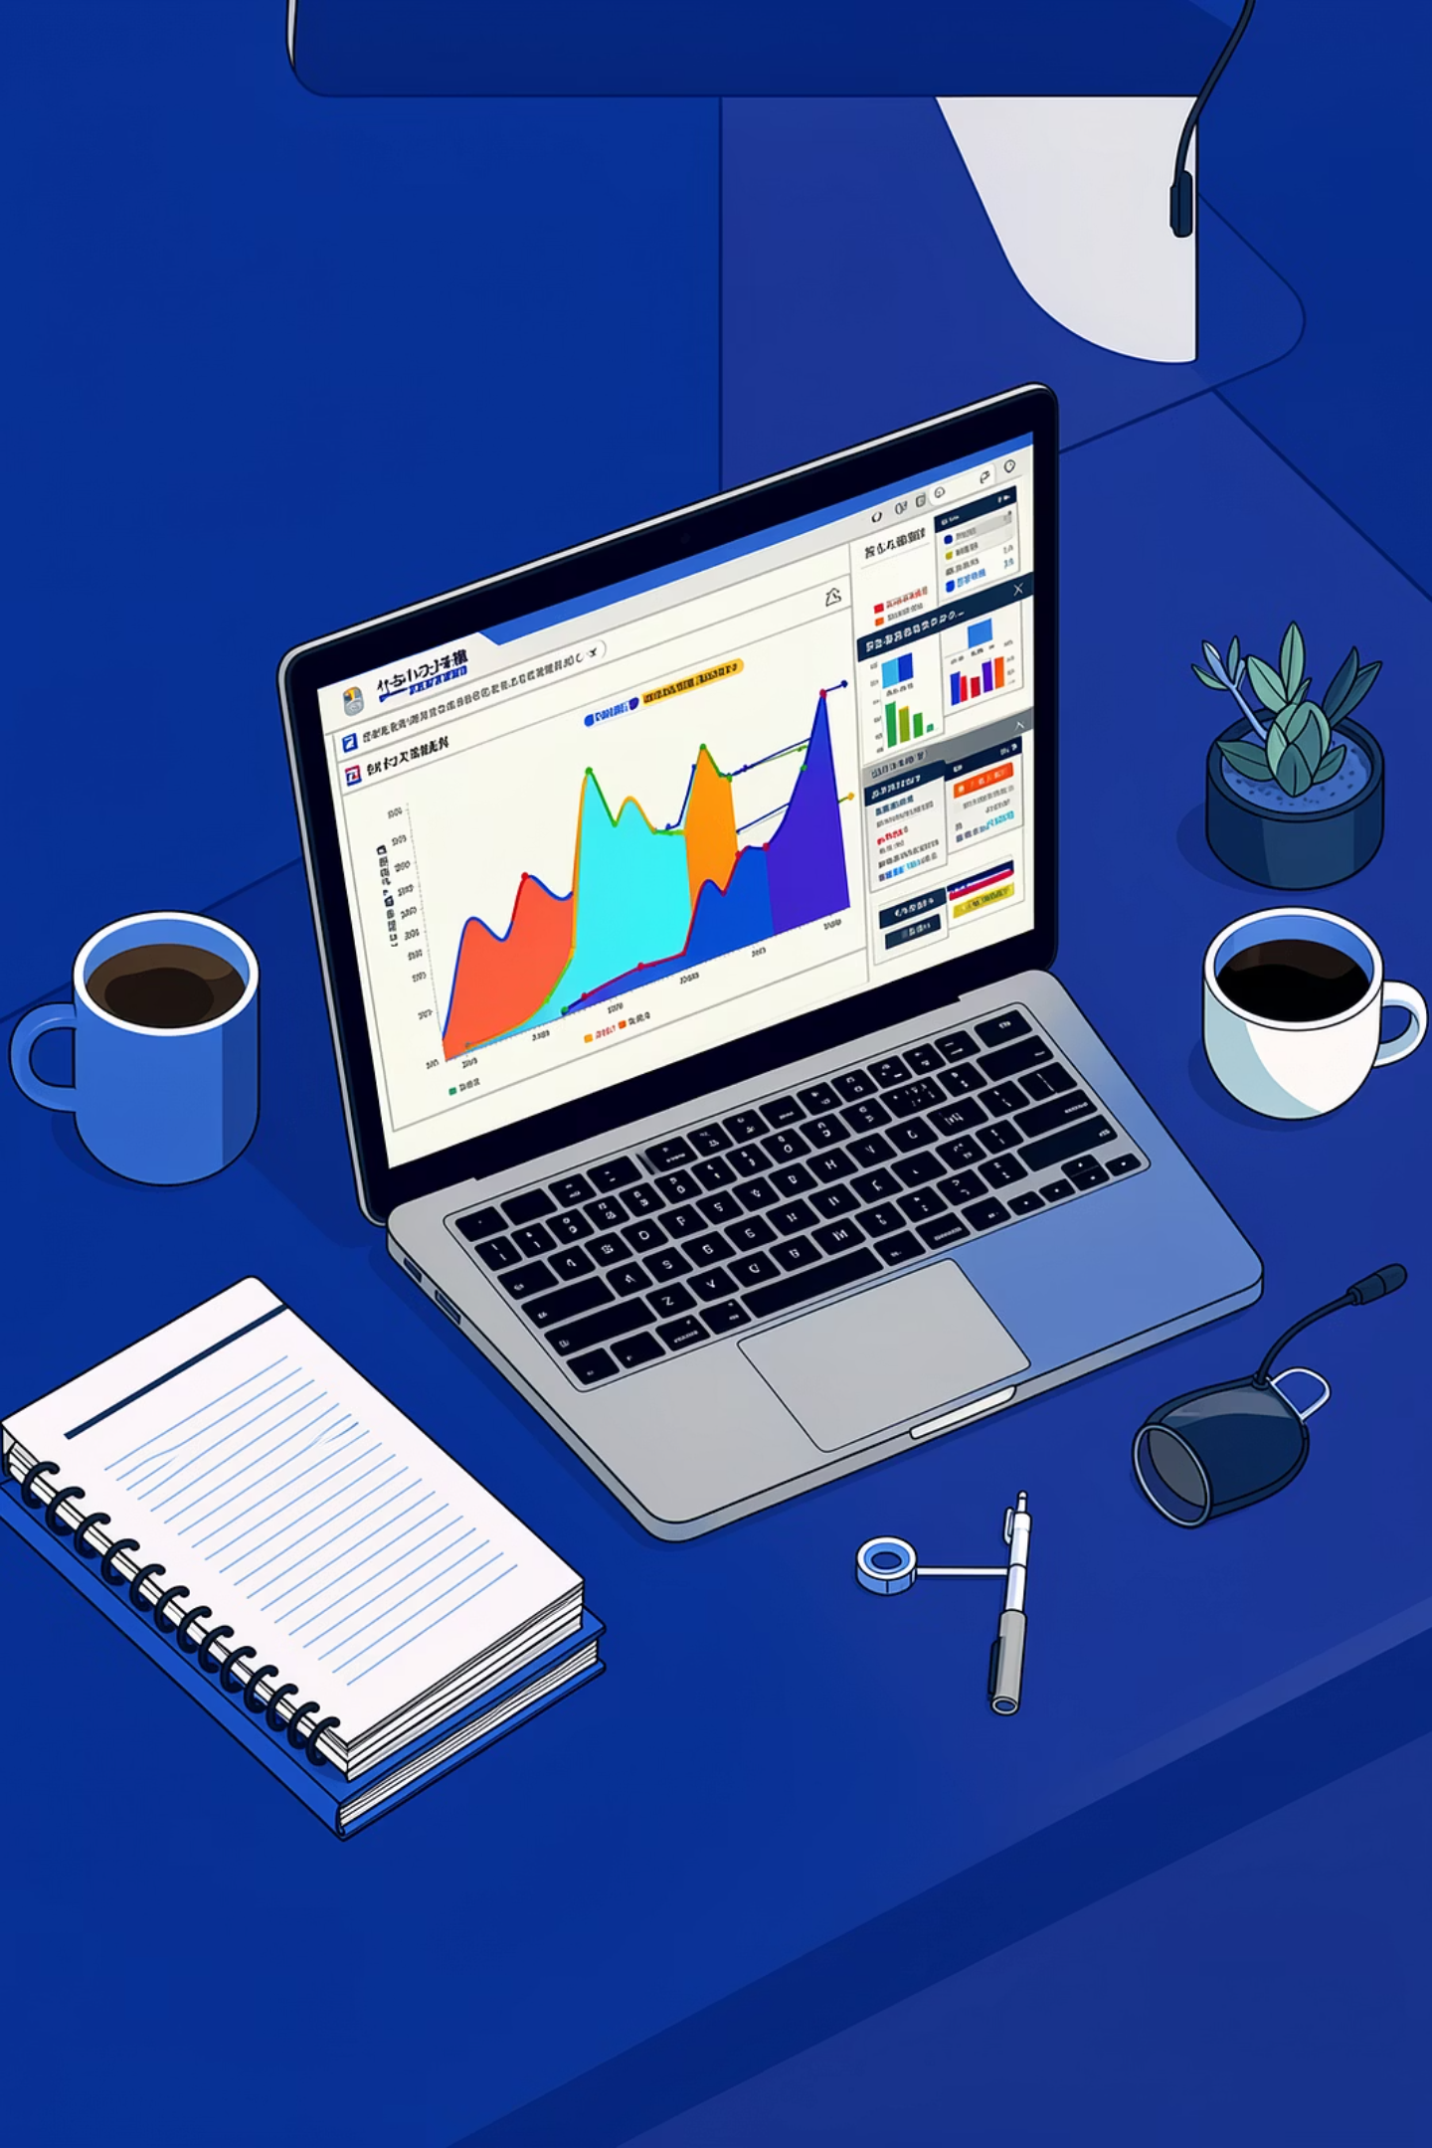
Introduction to Seaborn
While Matplotlib lays the foundation for plotting in Python, Seaborn builds upon it to offer a high-level interface for drawing attractive and informative statistical graphics. It's designed to make common statistical plotting tasks much easier and more aesthetically pleasing.
Matplotlib vs. Seaborn
Matplotlib
Seaborn
Low-level, highly customizable
Foundation for all Python plotting
Requires more code for complex plots
High-level, aesthetically pleasing
Built on Matplotlib, integrates with Pandas
Fewer lines of code for statistical plots
Why Seaborn is Popular
Beautiful Defaults
Seaborn plots are visually appealing right out of the box, requiring minimal tweaking for publication-quality figures.
Simplified Syntax
It significantly reduces the boilerplate code needed for complex statistical plots, often doing in one line what Matplotlib takes several to achieve.
Pandas Integration
Seamlessly works with Pandas DataFrames, making it intuitive to plot directly from your data structures.
Statistical Focus
Optimized for visualizing relationships between multiple variables, making it ideal for exploratory data analysis.
Installation & Import
# Installation (if not already installed)
pip install seaborn
# Import convention
import seaborn as sns
import matplotlib.pyplot as plt # Often used alongside Matplotlib
💡 Tip: Install Seaborn in your Python environment. You'll typically import both matplotlib.pyplot as plt and seaborn as sns, as they complement each other.

Slide 15
Pairplots — Visualizing Relationships
Seaborn's sns.pairplot() is a powerful tool for exploring relationships between multiple variables in a dataset. It creates a grid of scatter plots for each pair of numerical variables and histograms/KDE plots for each single variable on the diagonal.
Relationship Visualization
Multiple Variable Comparison
Quickly identifies correlations, clusters, and distributions across all numerical variables in your dataset.
Ideal for initial exploratory data analysis to get an overview of the dataset's structure.
Practical Examples
Iris Dataset
Tips Dataset
Visualize the relationships between sepal length, sepal width, petal length, and petal width for different Iris species. This helps in understanding how these features differentiate the species.
Explore how variables like total bill, tip amount, size of the party, and time of day relate to each other, segmented by gender or smoker status.
import seaborn as sns
import matplotlib.pyplot as plt
tips = sns.load_dataset("tips")
sns.pairplot(tips, hue="sex", palette="deep")
plt.suptitle("Pairplot of Tips Dataset by Sex", y=1.02)
plt.show()
import seaborn as sns
import matplotlib.pyplot as plt
iris = sns.load_dataset("iris")
sns.pairplot(iris, hue="species")
plt.suptitle("Pairplot of Iris Dataset by Species", y=1.02)
plt.show()

Slide 16
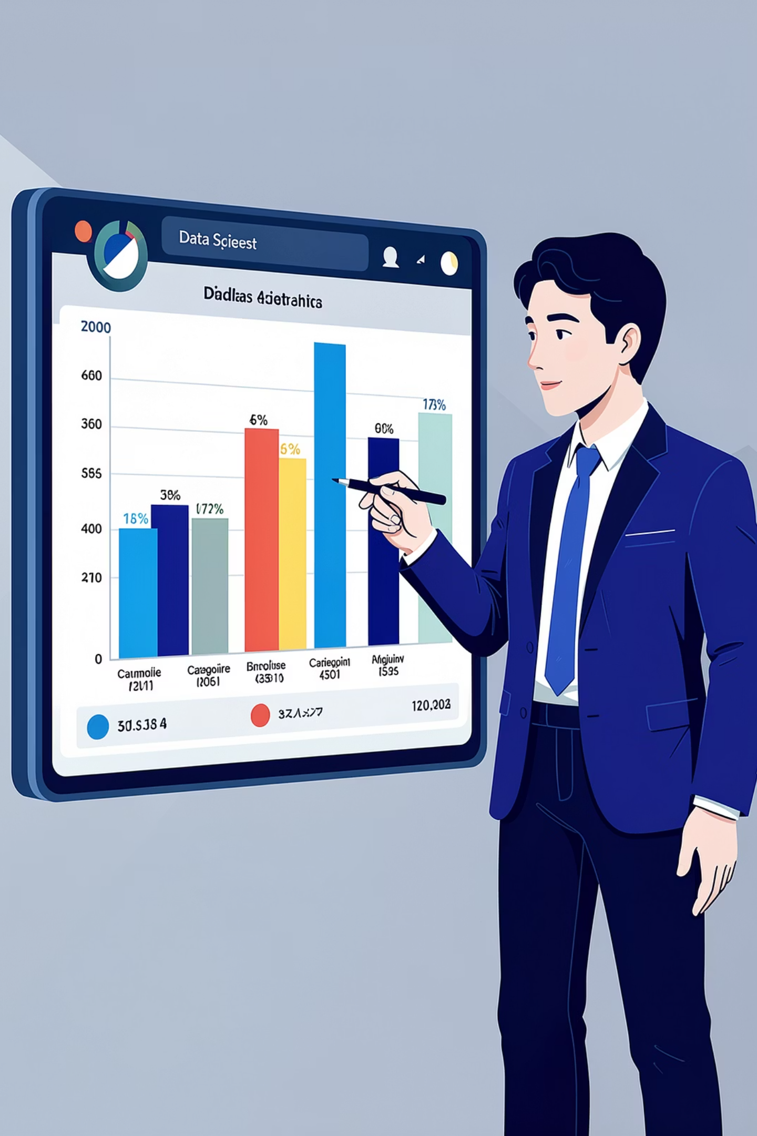
Countplots — Visualizing Frequencies
Seaborn's sns.countplot() is the perfect tool for visualizing the distribution of categorical data. It automatically calculates and displays the number of observations in each category, making frequency analysis straightforward and visually intuitive.
Categorical Data Visualization
Provides a quick and effective way to understand the composition of discrete variables, such as product types, survey responses, or demographic groups.
Automated Frequency Counting
Unlike plt.bar() which requires pre-calculating counts, sns.countplot() handles the counting internally, directly from your raw data.
Practical Examples
Gender Distribution
Analyze the gender breakdown in a dataset to understand demographic representation. The x or y parameter specifies the categorical column.
import seaborn as sns
import matplotlib.pyplot as plt
import pandas as pd
# Sample data
data = {'Gender': ['Male', 'Female', 'Male', 'Female', 'Other', 'Female', 'Male']}
df = pd.DataFrame(data)
sns.countplot(x='Gender', data=df)
plt.title('Gender Distribution')
plt.show()
Product Category Analysis
Visualize the number of items sold or listed within different product categories to identify popular segments or areas for growth.
import seaborn as sns
import matplotlib.pyplot as plt
import pandas as pd
# Sample data
data = {'Category': ['Electronics', 'Clothing', 'Electronics', 'Books', 'Clothing', 'Electronics', 'Home Goods', 'Books']}
df = pd.DataFrame(data)
sns.countplot(y='Category', data=df, palette='viridis') # Using y for horizontal bars
plt.title('Product Category Counts')
plt.show()
💡 Tip: sns.countplot() can take x or y parameters for vertical or horizontal bars respectively, and supports all standard Seaborn aesthetic enhancements like hue for sub-segmentation.

Slide 17
Lineplot and Barplot in Seaborn
Seaborn extends Matplotlib's capabilities with specialized functions for common plot types, offering enhanced aesthetics and simplified syntax for statistical visualizations. Let's explore sns.lineplot() and sns.barplot(), comparing them to their Matplotlib counterparts.
sns.lineplot() — Visualizing Trends
sns.barplot() — Comparing Categories
sns.lineplot() excels at displaying trends over time or relationships between two continuous variables, particularly when dealing with aggregated data. It automatically calculates and visualizes confidence intervals around the trend line, providing insight into the variability of the data. This is a significant advantage over Matplotlib's plt.plot(), which typically requires manual calculation and plotting of error bands.
sns.barplot() is designed for comparing numerical values across different categories. It automatically computes the mean (or other specified estimator) of a numerical variable for each category of a categorical variable, and plots a bar with an associated confidence interval. While plt.bar() requires you to pre-calculate the aggregates (e.g., means) and error bars, sns.barplot() simplifies this by taking raw data and performing the aggregation internally, making it faster for exploratory analysis.
import seaborn as sns
import matplotlib.pyplot as plt
import pandas as pd
# Sample data
data = {'Month': pd.to_datetime(['2023-01', '2023-02', '2023-03', '2023-04', '2023-05', '2023-06']),
'Value_A': [10, 12, 15, 13, 17, 19],
'Value_B': [8, 10, 13, 11, 15, 16]}
df = pd.DataFrame(data)
sns.lineplot(x='Month', y='Value_A', data=df, label='Series A', marker='o')
sns.lineplot(x='Month', y='Value_B', data=df, label='Series B', marker='x')
plt.title('Monthly Trends of Two Series')
plt.xlabel('Date')
plt.ylabel('Value')
plt.legend()
plt.grid(True, linestyle='--', alpha=0.7)
plt.tight_layout()
plt.show()
import seaborn as sns
import matplotlib.pyplot as plt
import pandas as pd
# Sample data
data = {'Category': ['A', 'B', 'C', 'D', 'E'],
'Value': [25, 30, 20, 35, 28],
'Group': ['X', 'Y', 'X', 'Y', 'X']}
df = pd.DataFrame(data)
sns.barplot(x='Category', y='Value', hue='Group', data=df, palette='viridis')
plt.title('Categorical Value Comparison by Group')
plt.xlabel('Category')
plt.ylabel('Average Value')
plt.tight_layout()
plt.show()
💡 Tip: Choose sns.lineplot() when you need to show continuous progression or statistical relationships over an ordered axis. Use sns.barplot() for comparing discrete categories, especially when you want to visualize aggregated statistics and their confidence intervals directly from your DataFrame.

Slide 18

Data Exploration Through Visualization
Exploratory Data Analysis (EDA) is a critical initial step in any data project. It involves summarizing the main characteristics of a dataset, often with visual methods, to understand the data, uncover insights, and prepare it for further analysis.
Finding Patterns
Discovering recurring structures or behaviors within the data, which can indicate underlying relationships or seasonal effects.
Detecting Trends
Identifying general directions or changes in data over time or across different categories.
Identifying Outliers
Spotting unusual data points that deviate significantly from other observations, often indicating errors or unique events.
Mini EDA Case Study: Car Mileage
Let's use a scatter plot to explore the 'mpg' (miles per gallon) and 'horsepower' relationship in the 'mpg' dataset, colored by 'origin'. This helps us find patterns, detect trends, and identify potential outliers.
import seaborn as sns
import matplotlib.pyplot as plt
mpg = sns.load_dataset("mpg")
sns.scatterplot(x="horsepower", y="mpg", hue="origin", data=mpg)
plt.title("Horsepower vs. MPG by Car Origin")
plt.show()
From this visualization, we can observe distinct clusters (patterns) for cars from different origins, a general inverse trend between horsepower and MPG, and easily spot cars with unusually high horsepower for their MPG (outliers).

Slide 19

Introduction to APIs: The Foundation of Connected Systems
In today's interconnected digital landscape, Applications Programming Interfaces (APIs) are the unsung heroes that enable different software systems to communicate, share data, and work together seamlessly.
What is an API?
What is a REST API?
An API is a set of defined rules and protocols that allows two software applications to talk to each other. Think of it like a menu at a restaurant: it lists what you can order (requests) and what you'll get back (responses), without you needing to know how the kitchen (the backend system) actually prepares it.
REST (Representational State Transfer) is a widely adopted architectural style for designing networked applications. A REST API uses standard HTTP requests (like GET, POST, PUT, DELETE) to interact with resources. It's known for being stateless and flexible, making it ideal for web services.
Client-Server Architecture
Real-World API Examples
This model underpins how APIs function. A client (e.g., your mobile app, web browser) sends a request to a server (where the data or service resides). The API acts as the intermediary, translating the client's request for the server and delivering the server's response back to the client.
Google Maps API: Allows websites/apps to embed maps, search for locations, and calculate routes.
Weather API: Provides current and forecast weather data to applications like weather apps or smart home devices.
News API: Aggregates news articles from various sources, letting publishers and developers create custom news feeds.
Payment APIs: Enables secure online transactions, integrating payment gateways like Stripe or PayPal into e-commerce platforms.

Slide 20
The `requests` Library: Simplifying HTTP
The requests library is an elegant and simple HTTP library for Python, designed to make sending HTTP requests extremely user-friendly. It abstracts away the complexities of making web requests, allowing developers to focus on interacting with APIs and retrieving data.
Installation
Before you can use the library, you need to install it. This is typically done using Python's package installer, pip.
pip install requests
Once installed, you can import it into your Python scripts and start making requests.
requests.get() — Retrieving Data
requests.post() — Submitting Data
The requests.get() method is used to send a GET request, which is the most common way to retrieve data from a web server. It takes a URL as its primary argument and returns a Response object.
The requests.post() method is used to send a POST request, typically for submitting new data to a server, like creating a new record in a database or submitting a form. It often includes data in the request body.
import requests
# Make a GET request to a public API
response = requests.get('https://jsonplaceholder.typicode.com/todos/1')
# Print the status code and content
print(f"Status Code: {response.status_code}")
print(f"Response Content: {response.json()}")
import requests
# Data to be sent in the POST request body
new_post_data = {
'title': 'My New Post',
'body': 'This is the content of my new post.',
'userId': 1
}
# Make a POST request to a public API
response = requests.post('https://jsonplaceholder.typicode.com/posts', json=new_post_data)
# Print the status code and response content
print(f"Status Code: {response.status_code}")
print(f"Response Content: {response.json()}")
This example fetches a single to-do item from a dummy API.
Here, we send new data to create a 'post' entry. The json parameter automatically serializes the
dictionary to JSON and sets the appropriate header.

Slide 21
Calling Public APIs: Practical Examples
Leveraging Python's requests library, we can easily interact with various public APIs to fetch real-time data. Let's explore how to make requests, interpret responses, and extract valuable information from Weather, News, and Currency Exchange APIs.
Weather API: Current Conditions
Retrieve current weather data for a specified location. We make a GET request and parse the JSON response to get details like temperature and conditions.
import requests
# Replace with your actual API key
API_KEY = "YOUR_WEATHER_API_KEY"
city = "London"
url = f"http://api.weatherapi.com/v1/current.json?key={API_KEY}&q={city}"
response = requests.get(url)
data = response.json()
print(f"City: {data['location']['name']}")
print(f"Temperature: {data['current']['temp_c']}°C")
print(f"Condition: {data['current']['condition']['text']}")
News API: Top Headlines
Currency Exchange API: Rates
Fetch the latest news headlines from a specific country. We send a GET request, and then iterate through the 'articles' list in the JSON response to display titles and sources.
Obtain real-time exchange rates between different currencies. We query the API for a base currency and extract the rate for a target currency from the 'conversion_rates' dictionary.
import requests
# Replace with your actual API key
API_KEY = "YOUR_NEWS_API_KEY"
country = "us" # United States
url = f"https://newsapi.org/v2/top-headlines?country={country}&apiKey={API_KEY}"
response = requests.get(url)
data = response.json()
if data['status'] == 'ok':
print("Top Headlines:")
for article in data['articles'][:3]: # Get first 3 articles
print(f"- {article['title']} (Source: {article['source']['name']})")
import requests
# Replace with your actual API key (e.g., from ExchangeRate-API.com)
API_KEY = "YOUR_EXCHANGE_RATE_API_KEY"
base_currency = "USD"
target_currency = "EUR"
url = f"https://v6.exchangerate-api.com/v6/{API_KEY}/latest/{base_currency}"
response = requests.get(url)
data = response.json()
if data['result'] == 'success':
rate = data['conversion_rates'][target_currency]
print(f"1 {base_currency} = {rate} {target_currency}")
else:
print(f"Error: {data['error-type']}")

Slide 22
Working with JSON Data
JSON (JavaScript Object Notation) is a lightweight, human-readable, and machine-parseable data-interchange format. It's widely used for sending data between a server and web application, and has become a standard for APIs.
Lightweight: Uses minimal characters.
Human-readable: Easy to understand at a glance.
Hierarchical: Supports nested data structures.
What is JSON?
JSON is a text-based format for representing structured data. It's language-independent, meaning it can be used with any programming language. Its simplicity and flexibility make it ideal for storing and exchanging information.
JSON Structure & Python Equivalents
Accessing Nested JSON
JSON is built on two core structures that directly map to Python data types:
In Python, once JSON data is loaded into a dictionary or list, you can access its elements using standard indexing and key lookup. The built-in json module is used to parse JSON strings into Python objects.
Objects: Unordered sets of key/value pairs, enclosed in curly braces {}. (Python dictionary)
Arrays: Ordered lists of values, enclosed in square brackets []. (Python list)
Other common data types include strings, numbers, booleans, and null values.
import json
# A JSON string with nested data
json_string = '''
{
"user": {
"id": 123,
"name": "Jane Doe",
"contact": {
"email": "jane@example.com",
"phone": "555-1234"
},
"roles": ["admin", "editor"]
}
}
'''
# Parse the JSON string
data = json.loads(json_string)
# Accessing nested elements
user_name = data['user']['name']
user_email = data['user']['contact']['email']
first_role = data['user']['roles'][0]
print(f"Name: {user_name}")
print(f"Email: {user_email}")
print(f"First Role: {first_role}")
{
"name": "Alice",
"age": 30,
"isStudent": false,
"courses": ["Math", "Science"]
}

Slide 23

API Keys and Authentication Basics
API keys are fundamental for controlling access to web services, acting as unique identifiers for applications to authenticate with an API. Understanding their purpose and proper handling is crucial for secure and efficient integration.
Why API Keys?
Security & Best Practices
API keys serve as tokens for identifying and authenticating an application or user when making requests to an API. They enable providers to monitor usage, apply rate limits, and gather analytics, ensuring fair access and system stability.
While API keys offer a layer of security, they are not a substitute for robust authentication. Treat them like passwords. Always store them securely, ideally in environment variables or a dedicated secret management service, never directly in your codebase.
Common Beginner Mistakes
Free API Services
Hardcoding keys directly into source code.
Committing keys to public version control systems (e.g., GitHub).
Exposing keys in client-side code (e.g., JavaScript in web pages).
Using a single key across multiple environments or applications.
Many public APIs offer free tiers for developers, often requiring an API key for access. These keys help manage usage within the free limits and protect the service from abuse. Always review the terms of service for any usage restrictions.

Slide 24
SUMMARY
Python Data Science & APIs: Cheat Sheet
A concise overview of key Matplotlib, Seaborn, and API concepts for quick reference.
📊 Matplotlib Basics
🎨 Seaborn Essentials
🌐 API Basics
plt.plot() → Line Chart
plt.bar() → Vertical Bar Chart
plt.barh() → Horizontal Bar Chart
plt.pie() → Pie Chart
plt.hist() → Histogram
plt.scatter() → Scatter Plot
sns.heatmap() → Correlation Heatmap
sns.pairplot() → Relationship Visualization
sns.boxplot() → Outlier Detection
sns.violinplot() → Distribution Shape
sns.countplot() → Category Count
sns.lineplot() → Trend Analysis
sns.barplot() → Statistical Comparison
API = Communication between applications
REST API uses HTTP requests
HTTP Methods
GET → Fetch data
POST → Send data
PUT → Update data
DELETE → Remove data
Common Functions
plt.xlabel() / plt.ylabel()
plt.title() / plt.legend()
plt.subplot()
plt.savefig()
Styling
sns.set_style("darkgrid")
sns.color_palette("Set2")
🐍 Requests Library
import requests
response = requests.get(url)
data = response.json()
🔍 Data Visualization Purpose
✔ Identify trends
✔ Compare values
✔ Detect outliers
✔ Understand distributions
✔ Generate business insights
Important Response Functions
status_code
json()
text
💡 Quick Tips
✔ Use Line Charts for trends
✔ Use Bar Charts for comparisons
✔ Use Histograms for distributions
✔ Use Scatter Plots for relationships
✔ Use Heatmaps for correlations

